Slide 1
Cloud Computing
Service and Deployment Models

Slide 2
Match the following
On-demand self- Service | Clusters
Jobs, Batches and Batch Processing | Internet Computing
Computing connect organizations located in different geographical locations. | Cloud Computing
A group of linked computers, working together closely thus in many respects forming a single computer. | Mainframe Computing

Slide 3
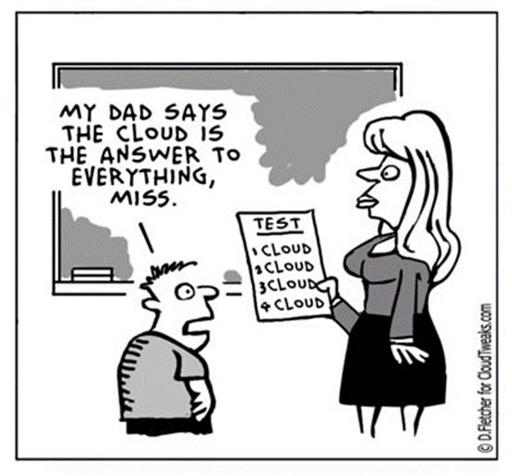
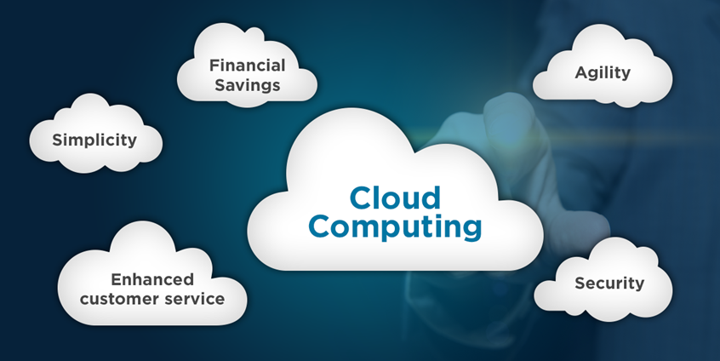
What is Cloud Computing ?
Cloud Computing refers to manipulating, configuring, and accessing the hardware and software resources remotely. It offers online data storage, infrastructure, and applications.
“I don’t care where my servers are, who manages them, where my documents are stored, or where my applications are hosted. I just want them always available and access them from any device connected through Internet. And I am willing to pay for this service for as a long as I need it”

Slide 4
Formal Definition
Cloud computing is a model for enabling ubiquitous, convenient, on-demand network access to a shared pool of configurable computing resources (e.g., networks, servers, storage, applications and services) that can be rapidly provisioned and released with minimal management effort or service provider interaction.

Slide 5
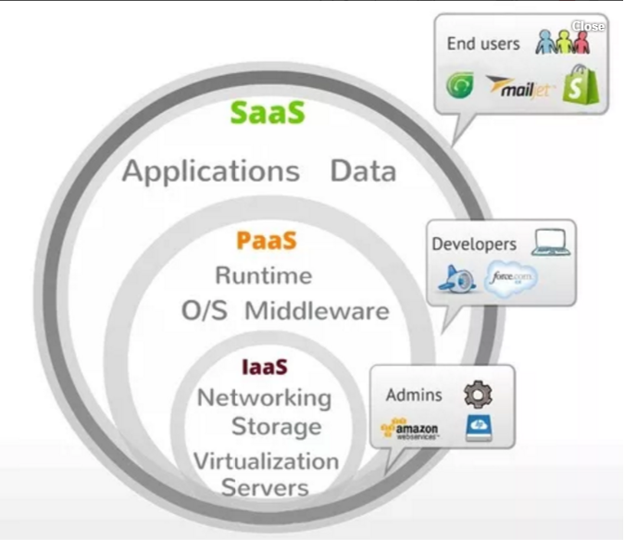
Service models
Depending upon the requirement a user can opt for any of the three models
Software as a Service (SaaS)
Platform as a Service (PaaS)
Infrastructure as a Service (IaaS)

Slide 6
Software as a Service (SaaS)
Consumer is to use the provider’s applications running on a cloud infrastructure.
Accessible from various client devices through either a thin client interface, such as a web browser (e.g., web-based email), or a program interface.
Consumer does not manage or control the underlying cloud infrastructure including network, servers, operating systems, storage, or even individual application capabilities.
Examples: Google Docs, Google Apps, Box, Office 365, Dropbox etc.
This is like borrowing a reference book from a library. You go, read the book, return it and come back.

Slide 7
Characteristics of SaaS
Web access to commercial software.
Software is managed from a central location.
Software delivered in a “one to many” model.
Users not required to handle software upgrades and patches
Application Programming Interfaces (APIs) allow for integration between different pieces of software.

Slide 8
When to go for SaaS
Applications where there is significant interplay between the organization and the outside world.
For example, email , newsletter campaign software .
Applications that have a significant need for web or mobile access.
Eg . Mobile sales management software
Software that is only to be used for a short term need.
Collaboration software for a specific project
Software where demand spikes significantly
Tax or billing software used once a month

Slide 9
Platform as a Service (PaaS)
The consumer is to deploy onto the cloud infrastructure consumer-created or acquired applications created using programming languages, libraries, services, and tools supported by the provider.
The consumer does not manage or control the underlying cloud infrastructure including network, servers, operating systems, or storage,
but has control over the deployed applications and possibly configuration settings for the application-hosting environment.
You have your choice of toppings in ice cream, but there are only a few bases for the toppings – a bowl, or flavour and so on..,

Slide 10
Characteristics of PaaS
Services to develop, test, deploy, host and maintain applications in the same integrated development environment. All the varying services needed to fulfil the application development process.
Multi-tenant architecture where multiple concurrent users utilize the same development application.
Built in scalability of deployed software including load balancing and failover
Integration with web services and databases via common standards

Slide 11
When to go for PaaS
PaaS is especially useful in any situation where multiple developers will be working on a development project or where other external parties need to interact with the development process.
Students/Developers can use the services provided by the cloud vendors like Amazon EC2, Bluemix or Azure to run their applications on the cloud provided by them without even actually investing anything in establishing the infrastructure physically.

Slide 12
Infrastructure as a Service (IaaS)
Infrastructure as a Service (IaaS) is a way of delivering Cloud Computing infrastructure - servers, storage, network and operating systems – as an on-demand service.
Rather than purchasing servers, software, data center space or network equipment, clients instead buy those resources as a fully outsourced service on demand.
It lets you build virtual infrastructure that mimics these resources, which can be created, reconfigured, resized, and removed within moments, as and when a task requires it.
Examples: Amazon AWS (EC2), Rackspace, Openstack etc.

Slide 13
Characteristics of IaaS
Resources are distributed as a service
Allows for dynamic scaling
Has a variable cost, utility pricing model
Generally includes multiple users on a single piece of hardware

Slide 14
When to go for IaaS
Where demand is very volatile – any time there are significant spikes and troughs in terms of demand on the infrastructure.
For new organizations without the capital to invest in hardware.
Where the organization is growing rapidly and scaling hardware would be problematic.
Where there is pressure on the organization to limit capital expenditure and to move to operating expenditure.

Slide 15
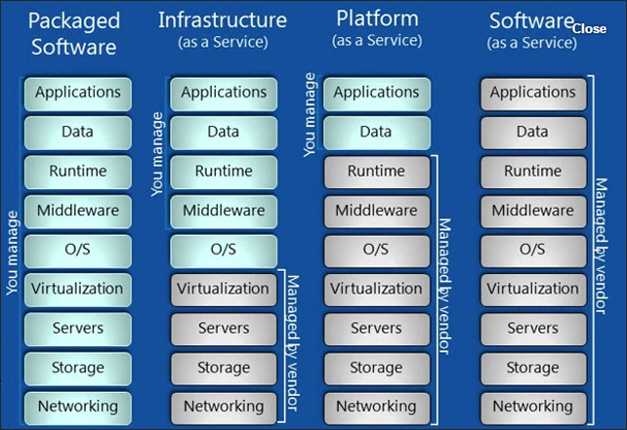
Difference between IaaS PaaS & SaaS

Slide 16
Difference between IaaS PaaS & SaaS
Features | Iaas | PaaS | SaaS
What you get | You get the infrastructure & pay accordingly .Freedom to use or install any OS, software or composition | Here you get what you demand. Software, hardware, OS, web environment. You get the platform to use & pay accordingly | Here you don’t have to worry about anything. A pre-installed, pre-configured package as per your requirement is given and you only need to pay accordingly.
Importance | The basic layer of Computing | Top of IaaS | It is like a Complete package of services
Technical Difficulties | Technical knowledge required | You get the Basic setup but still the knowledge of subject is required. | No need to worry about technicalities. The SaaS provider company handles everything.
Deals with | Virtual Machines, Storage (Hard Disks), Servers, Network, Load Balancers etc | Runtimes (like java runtimes), Databases (like mySql, Oracle), Web Servers (tomcat etc) | Applications like email (Gmail, Yahoo mail etc), Social Networking sites (Facebook etc)
Popularity Graph | Popular among highly skilled developers, researchers who require custom configuration as per their requirement or field of research. | Most popular among developers as they can focus on the development of their apps or scripts. They don’t have to worry about traffic load or server management etc. | Most popular among normal consumers or companies which reply on softwares such as email, file sharing, social networking as they don’t have to worry about the technicalities.

Slide 17
IaaS PaaS & SaaS
With IaaS, it’s like leasing a car. Keeping the car repaired is someone else’s problem, you just need to supply it with fuel (setting it up, maintaining software, etc.) and you get to go pretty much wherever you want to.
PaaS is a bit like getting a cab. You get in and choose where you want to go to and how to get there. Keeping the car running and figuring out the details is up to the driver.
SaaS is a bit like public transport . Cheap, someone else takes care of pretty much everything, you just get to use it. This comes at the price of not always getting as close as you want (less customizability)

Slide 18
WHAT IS NEW IN CLOUD COMPUTING
The illusion of infinite computing resources available on demand, thereby eliminating the need for Cloud Computing users to plan far ahead for provisioning.
The elimination of an up-front commitment by Cloud users, thereby allowing companies to start small and increase hardware resources only when there is an increase in their needs.
The ability to pay for use of computing resources on a short-term basis as needed (e.g., processors by the hour and storage by the day) and release them as needed, thereby rewarding conservation by letting machines and storage go when they are no longer useful.

Slide 19
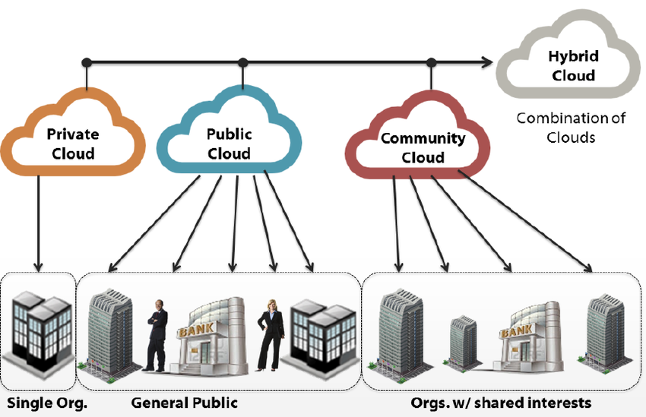
Deployment models

Slide 20
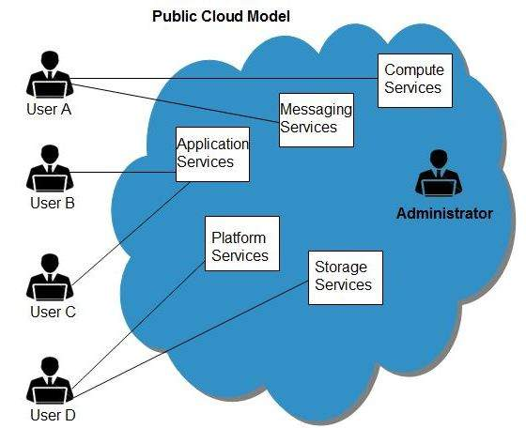
Public Cloud
It allows systems and services to be easily accessible to general public.
Google , Amazon and Microsoft offers public cloud via Internet.

Slide 21
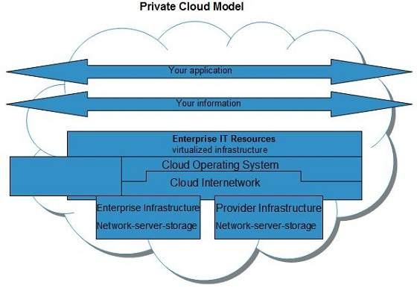
Private Cloud
Allows systems and services to be accessible within an organization.
Only within a single organization

Slide 22
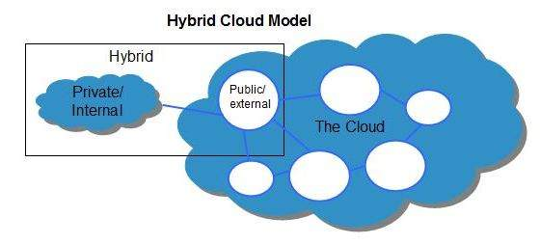
Hybrid Cloud Model
A mixture of public and private cloud.
Non-critical activities are performed using public cloud while the critical activities are performed using private cloud.

Slide 23
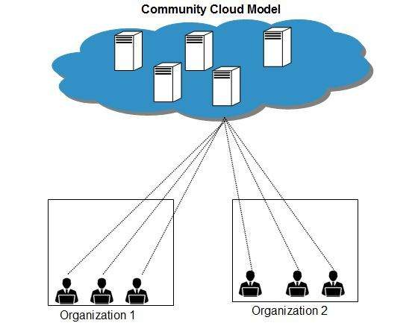
Community Cloud
It allows system and services to be accessible by group of organizations.
Shares the infrastructure between several organizations from a specific community.

Slide 24
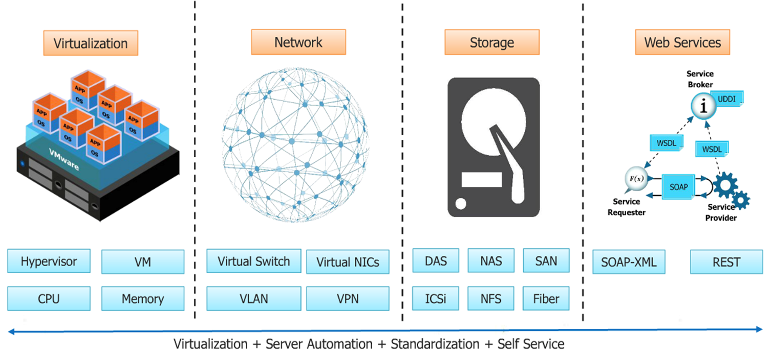
Building blocks of cloud computing

Slide 25
Application Programming Interface
An application programming interface (API) is a set of routines, data structures, object classes and/or protocols provided by libraries and/or operating system services in order to support the building of applications.
An API is a list of commands as well as the format of those commands that one program can send to another. It is used so that individual programs can communicate with one another directly and use each other's functions.
For example:
Without API:
An app finds the current weather in London by opening http://www.weather.com/ and reading the webpage like a human does, interpreting the content.
With API:
An app finds the current weather in London by sending a message to the weather.com API (in a structured format like JSON). The weather.com API then replies with a structured response.
Example APIs : Google APIs, YouTube APIs

Slide 26
Web Service
A Web service (also Web Service) is defined by the W3C as "a software system designed to support interoperable machine-to-machine interaction over a network“.
All Web services are APIs but all APIs are not Web services.
A Web service always needs a network for its operation whereas an API doesn’t need a network for its operation.

Slide 27
Why Virtualization ?
Virtualization improves IT resource utilization by treating your company's physical resources as pools from which virtual resources can be dynamically allocated.
Virtualization involves a shift in thinking from physical to logical, treating IT resources as logical resources rather than separate physical resources.
Consolidation to reduce hardware cost.
Optimization of workloads.
IT flexibility and responsiveness.

Slide 28
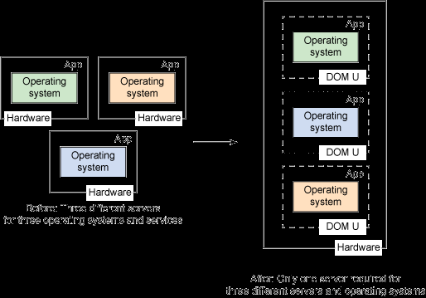
Virtualization
Virtualization is the creation of flexible substitutes for actual resources — substitutes that have the same functions and external interfaces as their actual counterparts but that differ in attributes such as size, performance, and cost.
These substitutes are called virtual
resources; their users are typically unaware
of the substitution.

Slide 29
Virtualization
Virtualization is a technique, which allows to share single physical instance of an application or resource among multiple organizations or tenants (customers).
It does so by assigning a logical name to a physical resource and providing a pointer to that physical resource on demand.
Creating a virtual machine over existing operating system and hardware is referred as Hardware Virtualization.
Virtual Machines provide an environment that is logically separated from the underlying hardware.
The machine on which the virtual machine is created is known as host machine and virtual machine is referred as a guest machine.

Slide 30
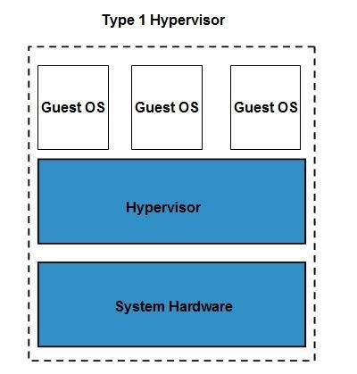
Hypervisor
The hypervisor is a firmware or low-level program that acts as a Virtual Machine Manager.
Type 1 hypervisor executes on bare system.
Oracle VM, Sun xVM Server, VirtualLogic VLX are examples of Type 1 hypervisor.
The type1 hypervisor does not have any host
operating system because they are installed on a bare system.

Slide 31
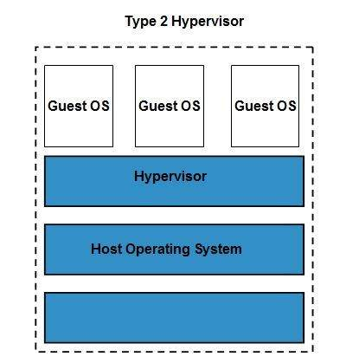
Type 2 hypervisor
A software interface that emulates the devices with which a system normally interacts.

Slide 32
Thanks

